Slide 1
Design and Analysis of Algorithms
CS602
Lecture 7
Greedy paradigm – III
Huffman coding
A generic way to design Greedy Algorithms

Slide 2
Recap of last lecture

Slide 3
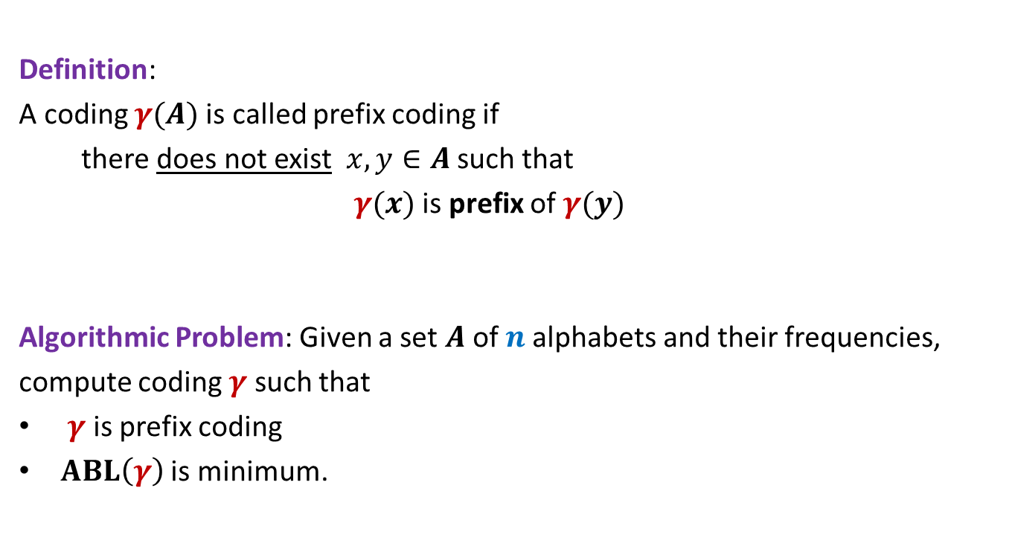
Prefix Coding
Definition:
A coding $γ(A)$is called prefix coding if
there does not exist $x,y∈A$ such that
$γ(x)$ is prefix of $γ(y)$
Algorithmic Problem: Given a set $A$of $n$alphabets and their frequencies,
compute coding $γ$ such that
$γ$ is prefix coding
$ABL\left(γ\right)$ is minimum.

Slide 4

The novel idea of Huffman
?
0
1
0
1
0
1
Binary coding
Labeled
Binary tree

Slide 5
A labeled binary tree
0
1
0
1
1
0
0
1
0
1
0
1
0
1

Slide 6
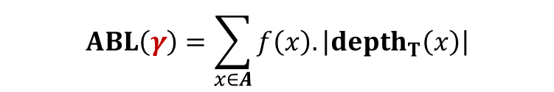
A labeled binary tree
leaf nodes → alphabets
Code of an alphabet =
0
1
01,
001,
0000,
11,
100,
10110,
10111
0
1
1
0
0
1
0
1
0
1
0
1
Label of path from root
$$ABL\left(γ\right)=\sum_{x∈A}{f\left(x\right).\left|depth_{T}\left(x\right)\right|}$$

Slide 7
Finding the labeled binary tree for
the optimal prefix codes

Slide 8


Homework
Imagine the labeled Binary tree corresponding to optimal prefix coding.
Can you make any inference about the node corresponding to the most frequent alphabet in this tree ?
Can you make any inference about the node corresponding to the least frequent alphabet in this tree ?
Non-decreasing order of frequency
$${f(a}_{i})≤{f(a}_{i+1})$$
$a_{1}$ , $a_{2}$ , … , $a_{n}$

Slide 9




Strategy: most frequent alphabet as child of root node
$$0.3$$
$$0.25$$
$$0.23$$
$$0.22$$

Slide 10

Strategy: most frequent alphabet as child of root node
0
1
$$0.3$$
$$0.25$$
$$0.23$$
$$0.22$$

Slide 11




Strategy: most frequent alphabet as child of root node
0
1
$$0.3$$
0
$$0.25$$
0
1
$$0.23$$
$$0.22$$
ABL = $2.15$

Slide 12





Strategy: most frequent alphabet as child of root node
0
1
0
0
1
$$0.3$$
$$0.25$$
$$0.23$$
$$0.22$$
ABL = $2.0$

Slide 13
Trying any other strategy ?
Instead, let us derive some properties that are satisfied by the
labeled binary tree of optimal prefix code ...

Slide 14
Is the following prefix coding optimal ?
full binary tree
0
1
0
1
1
0
0
1
0
1
0
1
0
1

Slide 15


Observations on the binary tree of the optimal prefix code
Lemma:
The binary tree corresponding to optimal prefix coding must be a full binary tree:
Every internal node has degree exactly 2.
Question: What next ?
We need to see the influence of frequencies on the optimal binary tree.
Non-decreasing order of frequency
$${f(a}_{i})≤{f(a}_{i+1})$$
$a_{1}$ , $a_{2}$ , … , $a_{n}$

Slide 16
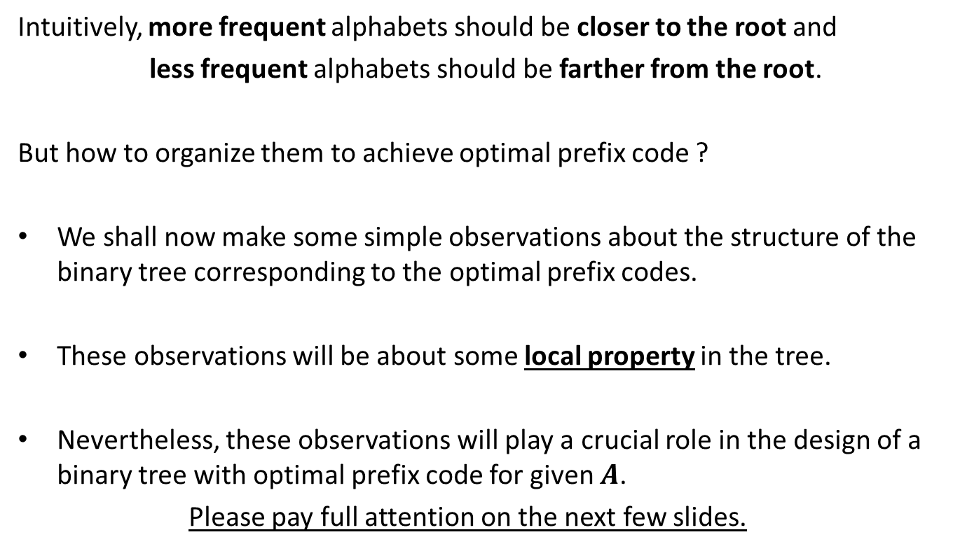
Observations on the binary tree of the optimal prefix code
Intuitively, more frequent alphabets should be closer to the root and
less frequent alphabets should be farther from the root.
But how to organize them to achieve optimal prefix code ?
We shall now make some simple observations about the structure of the binary tree corresponding to the optimal prefix codes.
These observations will be about some local property in the tree.
Nevertheless, these observations will play a crucial role in the design of a binary tree with optimal prefix code for given $A$.
Please pay full attention on the next few slides.

Slide 17

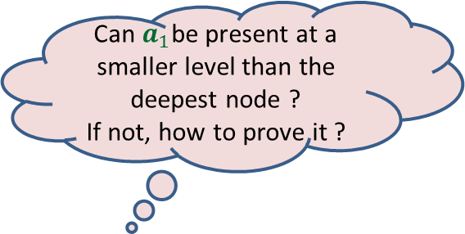

More Observations
Can $a_{1}$be present at a smaller level than the deepest node ?
If not, how to prove it ?
0
1
0
1
0
1
. . .
0
1
0
$$a_{1}$$
Deepest level
$$a_{i}$$

Slide 18


More Observations
0
1
1
Swapping $a_{1}$ with $a_{i}$ can not increase ABL.
0
1
0
. . .
0
1
0
$$a_{1}$$
Deepest level
$$a_{i}$$

Slide 19



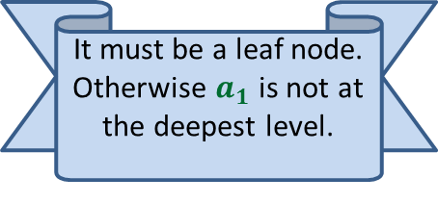


More Observations
0
1
Since the tree is full binary, $a_{1}$ must have a sibling. What can we say about it ?
1
Swapping $a_{2}$ with $a_{i}$ can not increase ABL.
0
1
0
It must be a leaf node. Otherwise $a_{1}$ is not at the deepest level.
. . .
What about $a_{2}$ ?
0
1
$$a_{2}$$
0
1
Deepest level
$$a_{1}$$
$$a_{i}$$

Slide 20
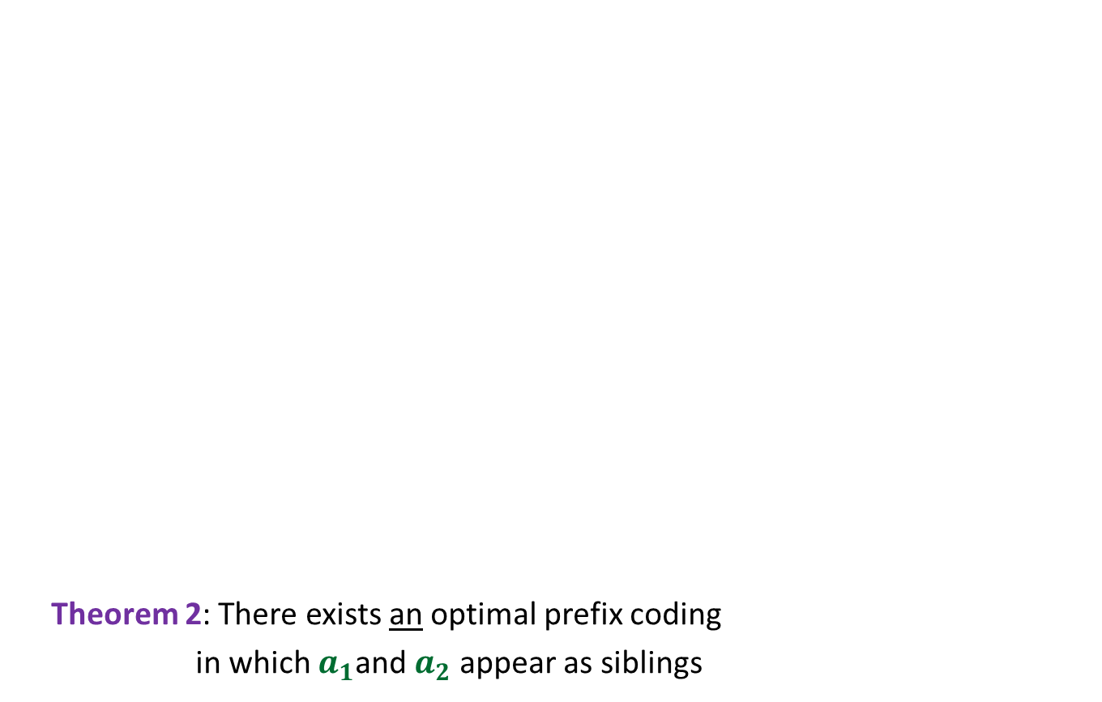

More Observations
0
1
Theorem 2: There exists an optimal prefix coding
in which $a_{1}$and $a_{2}$ appear as siblings
0
1
0
1
. . .
1
0
1
Deepest level
$$a_{1}$$
$$a_{2}$$

Slide 21
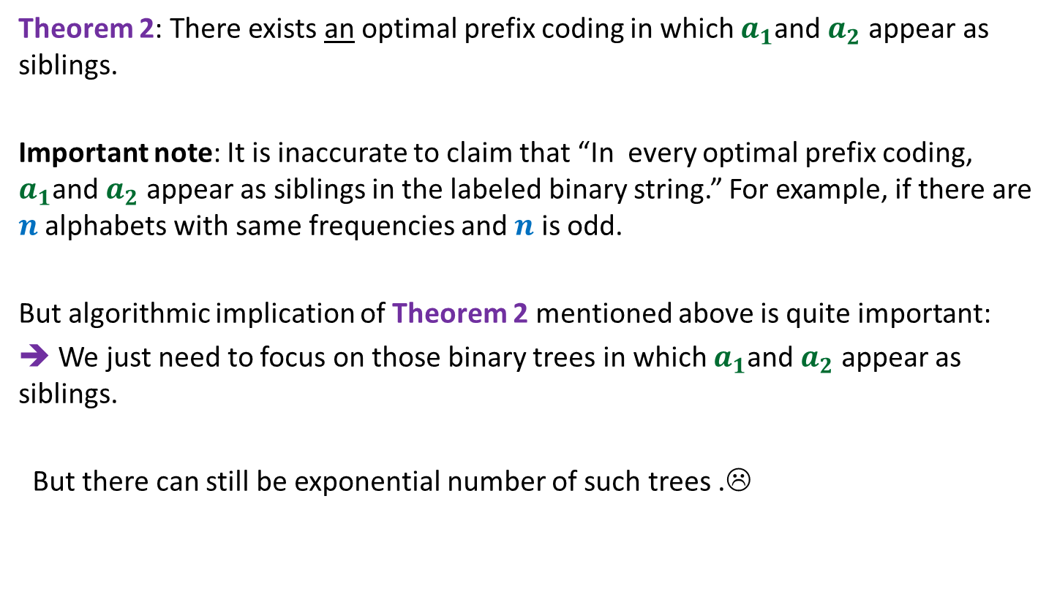
The important observation
Theorem 2: There exists an optimal prefix coding in which $a_{1}$and $a_{2}$ appear as siblings.
Important note: It is inaccurate to claim that “In every optimal prefix coding, $a_{1}$and $a_{2}$ appear as siblings in the labeled binary string.” For example, if there are $n$ alphabets with same frequencies and $n$ is odd.
But algorithmic implication of Theorem 2 mentioned above is quite important:
➔ We just need to focus on those binary trees in which $a_{1}$and $a_{2}$ appear as siblings.
But there can still be exponential number of such trees .☹

Slide 22

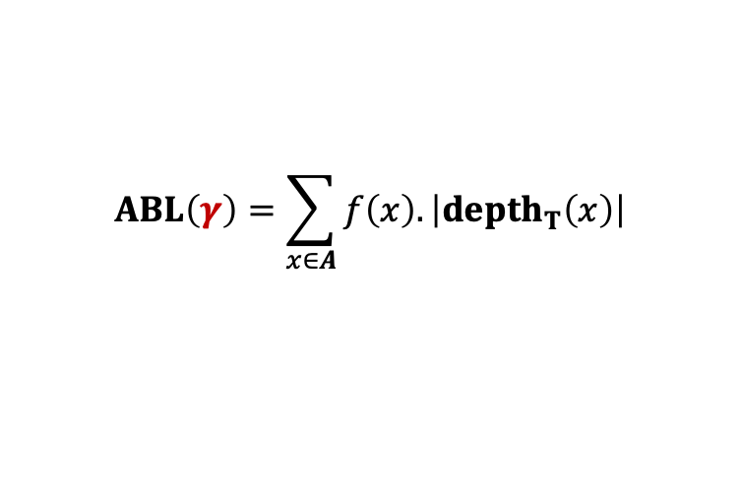

The binary tree of the optimal prefix code
0
1
0
1
0
1
. . .
1
0
1
Deepest level
$$a_{1}$$
$$a_{2}$$
Theorem: There exists an optimal prefix coding
in which $a_{1}$and $a_{2}$ appear as siblings
$$ABL\left(γ\right)=\sum_{x∈A}{f\left(x\right).\left|depth_{T}\left(x\right)\right|}$$

Slide 23



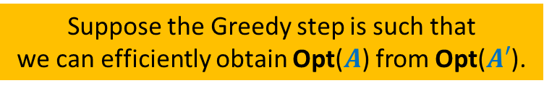

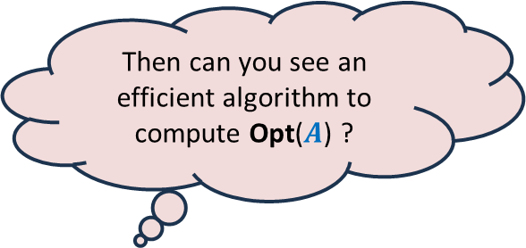



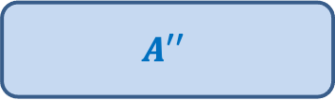
A generic way to design and analyse a greedy algorithm
Suppose the Greedy step is such that
we can efficiently obtain Opt($A$) from Opt($A′$).
P: a given optimization problem
So, all you need is to just design the Greedy step appropriately.
Opt($A$)
$$A$$
instance of size $n$of problem P
Then can you see an efficient algorithm to compute Opt($A$) ?
Greedy
step
?
Opt($A′$)
$$A′$$
instance of size $<n$of problem P
Ponder over this inference for some time.
Isn’t it amazing ?
Greedy
step
Yes, a simple recursive algorithm.☺
$$A′′$$
…
Opt($A′$)
Base case
Notes:
Let us illustrate its usefulness with the help of an example.

Slide 24
Finding the labeled binary tree for
the optimal prefix codes

Slide 25

The binary tree of the optimal prefix code
From this picture, can you design the greedy step that you will perform to compute the smaller instance ?
0
1
0
1
0
1
. . .
1
0
1
Deepest level
$$a_{1}$$
$$a_{2}$$
Theorem 2: There exists an optimal prefix coding
in which $a_{1}$and $a_{2}$ appear as siblings

Slide 26


The binary tree of the optimal prefix code
0
1
0
1
0
1
. . .
1
Deepest level
$a$’
$f\left(a\text{’}\right)=$ $f\left(a_{1}\right)+f\left(a_{2}\right)$

Slide 27
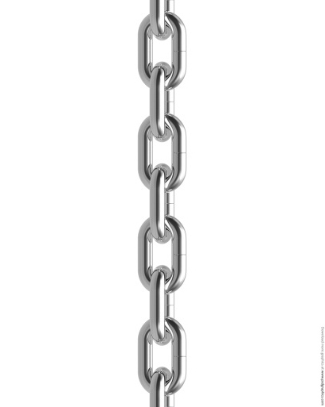



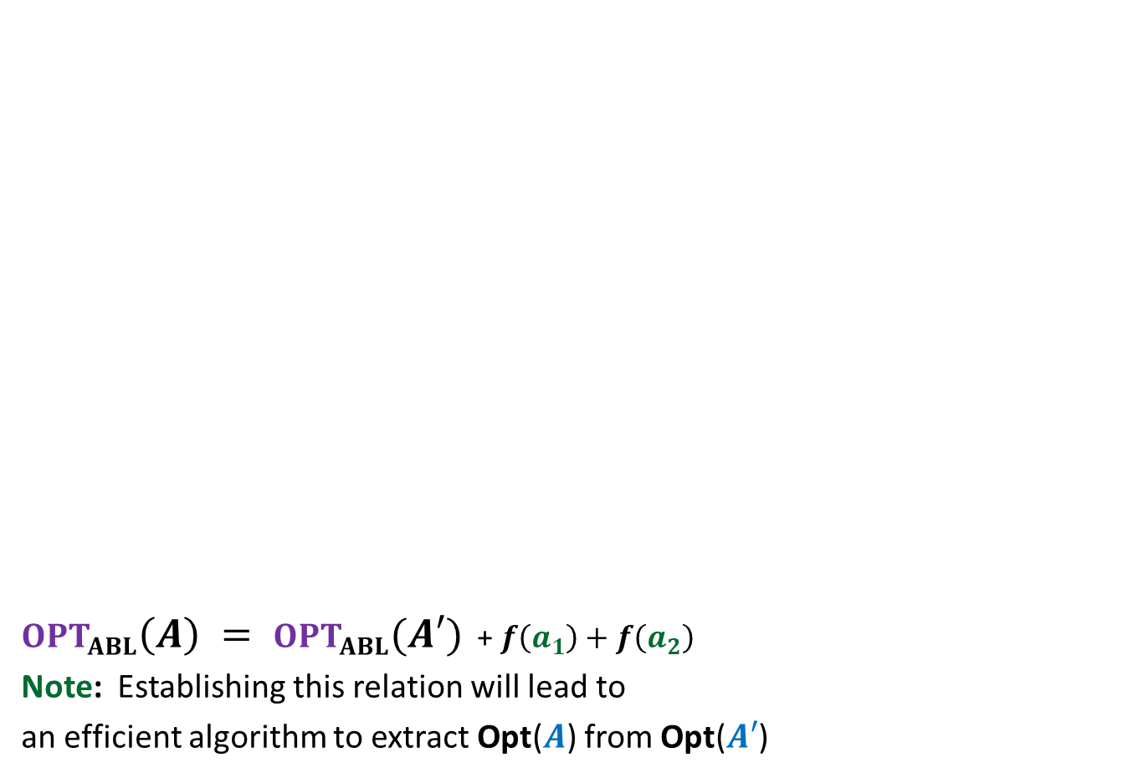





$OPT_{ABL}\left(A\right) = OPT_{ABL}(A′)$ + $f\left(a_{1}\right)+f\left(a_{2}\right)$
Note: Establishing this relation will lead to
an efficient algorithm to extract Opt($A$) from Opt($A′$)
Opt($A$)
$$A$$
$a_{1}$, $a_{2}$, $a_{3}$ , … … $a_{n}$
Greedy
step
Relation ?
Opt($A′$)
$$A′$$
$a_{3}$ , … … $a_{n}$
$$a′$$
$f\left(a\text{’}\right)=$ $f\left(a_{1}\right)+f\left(a_{2}\right)$
?

Slide 28
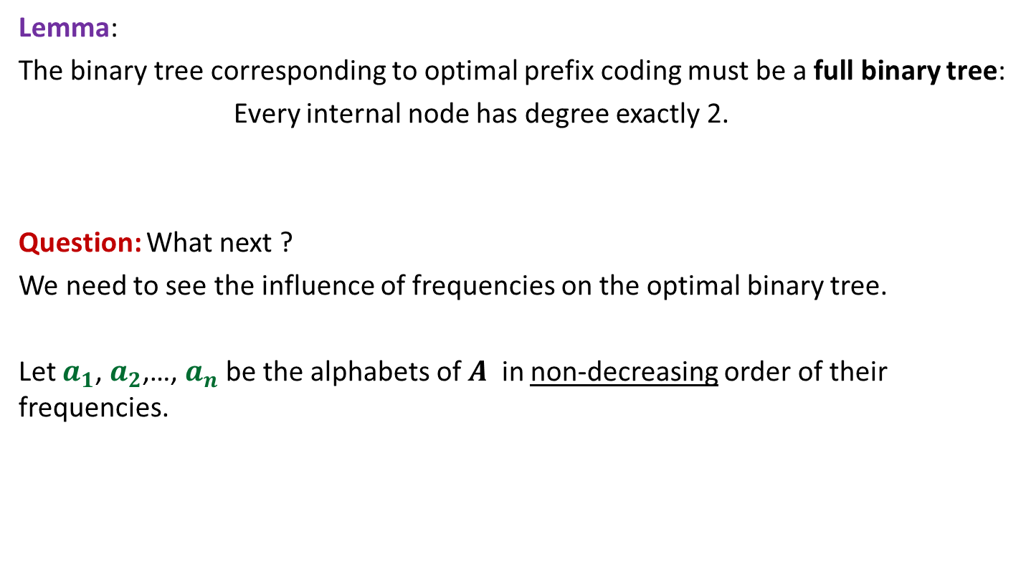
Proof for $OPT_{ABL}\left(A\right)=OPT_{ABL}(A′)$ + $f\left(a_{1}\right)+f\left(a_{2}\right)$
Spend some time thinking about the proof
before moving ahead.
☺

Slide 29
Proof for $OPT_{ABL}\left(A\right)=OPT_{ABL}(A′)$ + $f\left(a_{1}\right)+f\left(a_{2}\right)$

Slide 30
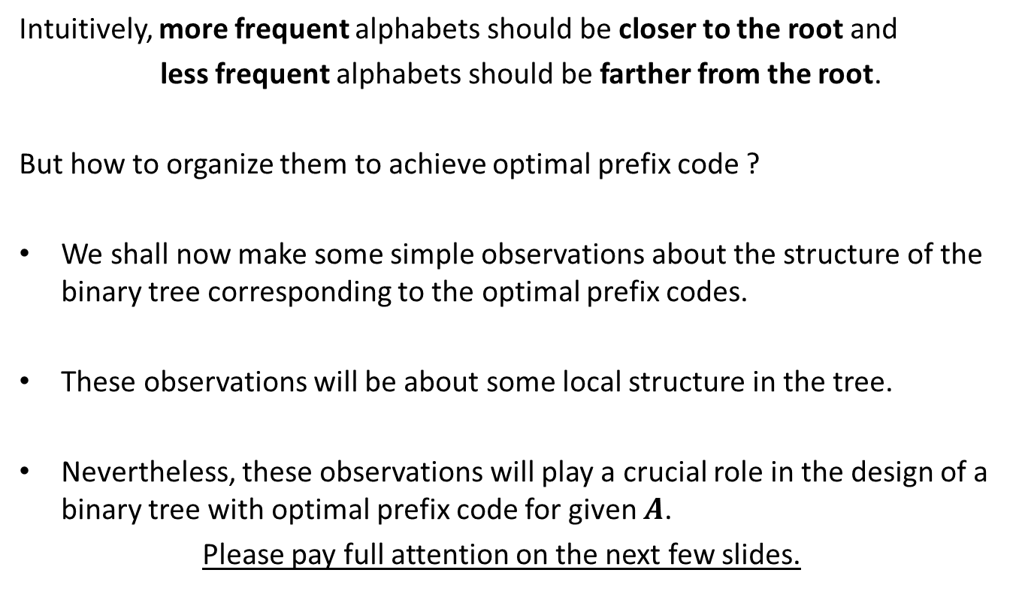
How to prove $OPT_{ABL}\left(A\right)=OPT_{ABL}(A′)$ + $f\left(a_{1}\right)+f\left(a_{2}\right)$ ?
Question: Can we derive a prefix coding for $A$from $OPT(A′)$ ?
Question: Can we derive a prefix coding for $A′$from $OPT(A)$ ?

Slide 31




A prefix coding for $A$from $OPT\left(A^{′}\right)$
$T′$: the binary tree corresponding to $OPT_{ABL}(A′)$
0
1
0
1
0
1
$$T′$$
. . .
1
$a$’

Slide 32


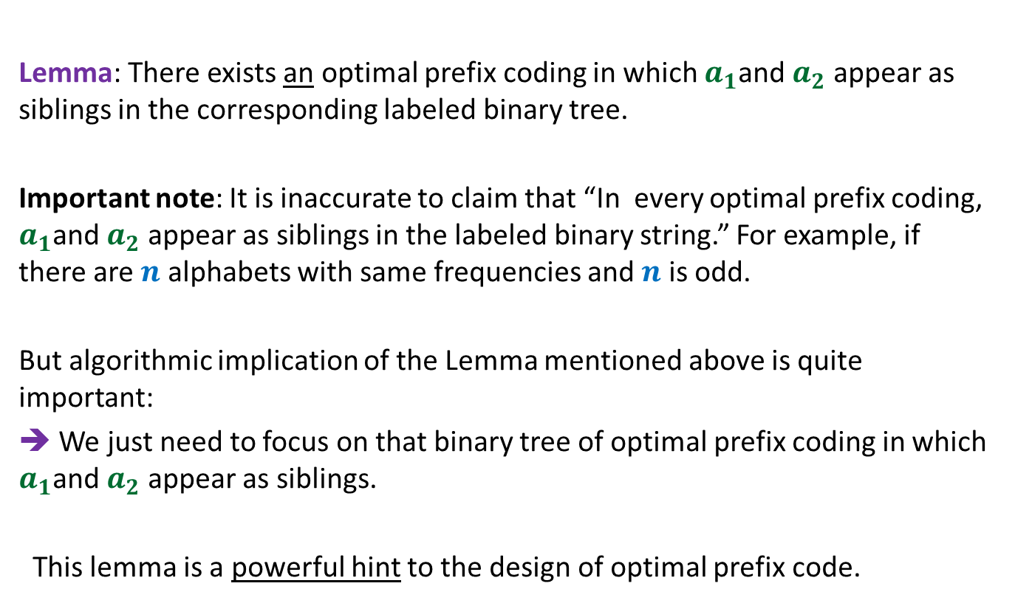

A prefix coding for $A$from $OPT\left(A^{′}\right)$
$T′$: the binary tree corresponding to $OPT_{ABL}(A′)$
This gives a prefix coding for $A$ with $ABL$ = ??
➔ $OPT_{ABL}\left(A\right)≤OPT_{ABL}(A′)$ + $f\left(a_{1}\right)+f\left(a_{2}\right)$
0
1
0
1
0
1
$$T′$$
. . .
1
0
1
$a$’
$$a_{1}$$
$$a_{2}$$
$OPT_{ABL}(A′)$ + $f\left(a_{1}\right)+f\left(a_{2}\right)$

Slide 33





A prefix coding for $A′$from $OPT(A)$
$T$: the binary tree corresponding to $OPT_{ABL}(A)$
0
1
Using Theorem 2
0
1
0
1
$$T$$
. . .
1
0
1
Deepest level
$$a_{1}$$
$$a_{2}$$

Slide 34

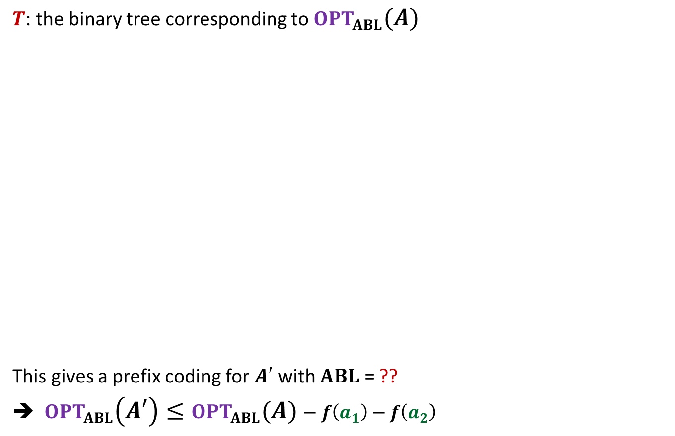

A prefix coding for $A′$from $OPT(A)$
$T$: the binary tree corresponding to $OPT_{ABL}(A)$
This gives a prefix coding for $A′$ with $ABL$ = ??
➔ $OPT_{ABL}\left(A′\right)≤OPT_{ABL}(A)−f\left(a_{1}\right)−f\left(a_{2}\right)$
0
1
Using Theorem 2
0
1
0
1
$$T$$
. . .
1
0
1
$a$’
Deepest level
$$a_{1}$$
$$a_{2}$$
$$OPT_{ABL}\left(A\right)−f\left(a_{1}\right)−f\left(a_{2}\right)$$

Slide 35
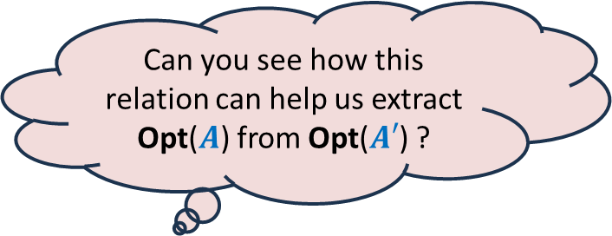
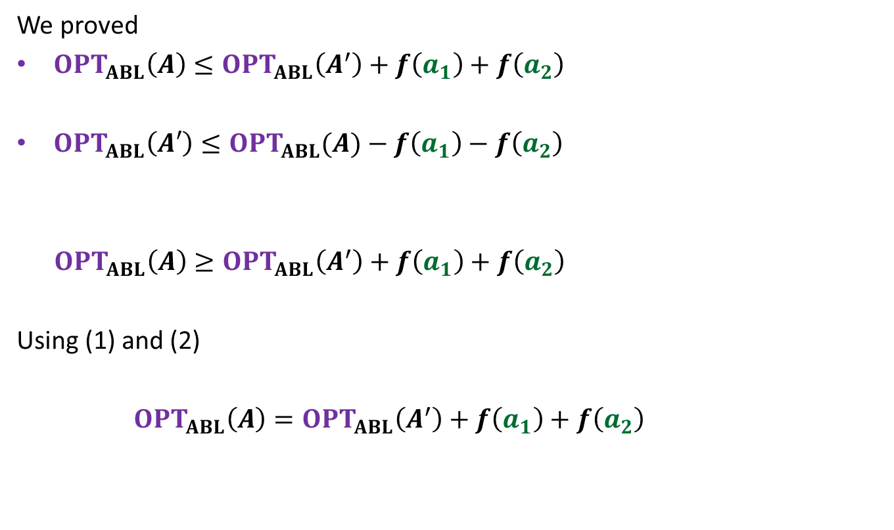
We proved
$OPT_{ABL}\left(A\right)≤OPT_{ABL}\left(A^{′}\right)+f\left(a_{1}\right)+f\left(a_{2}\right)$
$OPT_{ABL}\left(A′\right)≤OPT_{ABL}(A)−f\left(a_{1}\right)−f\left(a_{2}\right)$
$OPT_{ABL}\left(A\right)≥OPT_{ABL}\left(A^{′}\right)+f\left(a_{1}\right)+f\left(a_{2}\right)$
Using (1) and (2)
$OPT_{ABL}\left(A\right)=OPT_{ABL}\left(A^{′}\right)+f\left(a_{1}\right)+f\left(a_{2}\right)$
(1)
Can you see how this relation can help us extract Opt($A$) from Opt($A′$) ?
(2)

Slide 36

We have established
$$OPT_{ABL}\left(A\right)=OPT_{ABL}\left(A^{′}\right)+f\left(a_{1}\right)+f\left(a_{2}\right)$$
A prefix coding for $A$from $OPT\left(A^{′}\right)$
So
$T′$: the binary tree corresponding to $OPT_{ABL}(A′)$
This gives a prefix coding for $A$ with $ABL$ = ??
➔ $OPT_{ABL}\left(A\right)≤OPT_{ABL}(A′)$ + $f\left(a_{1}\right)+f\left(a_{2}\right)$
0
1
0
1
0
1
$$T′$$
. . .
1
0
1
$a$’
$$a_{1}$$
$$a_{2}$$
$OPT_{ABL}(A′)$ + $f\left(a_{1}\right)+f\left(a_{2}\right)$
$$=$$

Slide 37

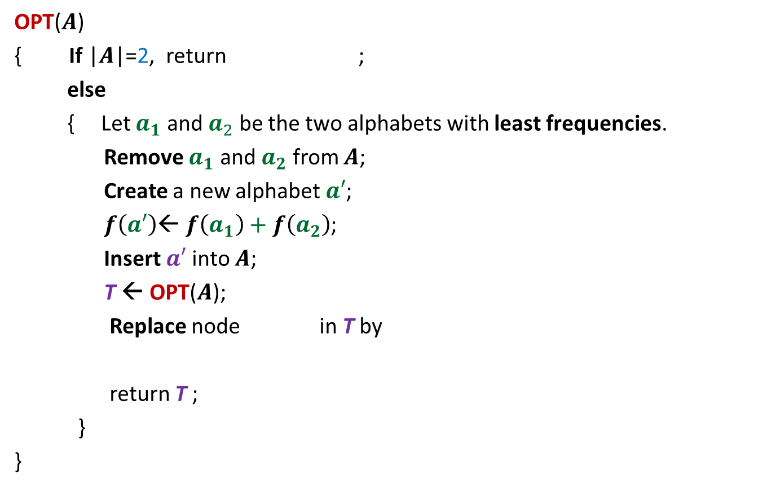







The algorithm based on $OPT_{ABL}\left(A\right)=OPT_{ABL}(A′)$ + $f\left(a_{1}\right)+f\left(a_{2}\right)$
OPT($A$)
{ If |$A$|=2, return ;
else
{ Let $a_{1}$ and $a_{2}$ be the two alphabets with least frequencies.
Remove $a_{1}$ and $a_{2}$ from $A$;
Create a new alphabet $a′$;
$f\left(a′\right)$← $f\left(a_{1}\right)+f\left(a_{2}\right)$;
Insert $a′$into $A$;
T ← OPT($A$);
Replace node in T by
return T ;
}
}
0
1
$$a_{1}$$
$$a_{2}$$
$O(n^{2})$ time complexity
Homework:
Achieve $O(n log n)$ time complexity
0
1
$a$’
$$a_{1}$$
$$a_{2}$$

